Slide 1
The Document Object Model

Slide 2






The Document Object Model
Learning Objectives
Define DOM
Select an element from an HTML page using JavaScript
Change an element's styles

Slide 3

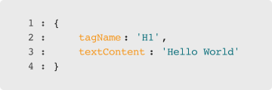

Question: Expressing UI
What do these two pieces of code have in common? How are they different?
Notes:
1. These two pieces of code describe the same data
2. Just in different ways

Slide 4
Question: Expressing UI
What type of variable is this?
Notes:
1. It's a JavaScript object
2. That describes an HTML element

Slide 5



HTML & The DOM
The Browser
The DOM
HTML
Notes:
The browser takes in HTML and creates a JavaScript object that represents it.
We call that object 'The DOM'

Slide 6


The DOM
Document
Notes:
What comes to mind when you hear the word document? (A page, what the user sees)

Slide 7
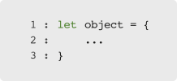
The DOM
Document
Object
Notes:
What do you think object refers to here in a JavaScript context (a JS object, combination of data and methods)

Slide 8

The DOM
Document
Object
Model
Notes:
Model is a word which in software engineering usually means 'represents'- in this case the DOM is an object which represents the document

Slide 9
Using the DOM
Notes:
We can use the data and methods of the DOM to change what the user sees with JavaScript

Slide 10

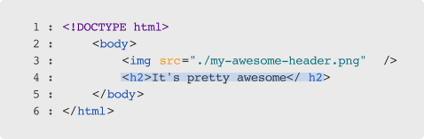

Traversing the DOM
Notes:
The DOM is a global variable named 'document'.
It is a big, nested object. We could get to specific elements in the DOM using '.' and '[]'...

Slide 11
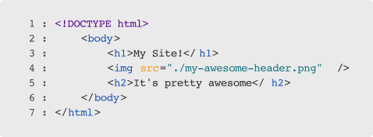

Question
What would myHeader be now?
Notes:
...But what would happen if we later added another element to the HTML?

Slide 12
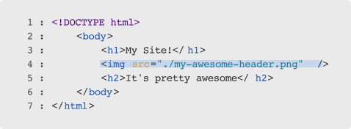
Answer
Now myHeader is actually an image!
Notes:
Traversing the DOM manually would be both tedious and brittle (prone to break often)

Slide 13


querySelector
A function
Takes in a CSS selector
Returns a DOM element
Notes:
Instead, we can select elements the way we do with CSS, using a built-in function called 'querySelector'

Slide 14
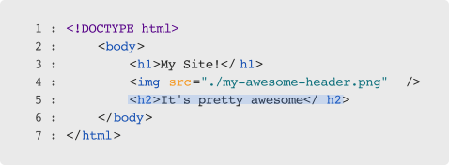

querySelector by Tag Name
Notes:
Using querySelector, we can select elements by tag name

Slide 15
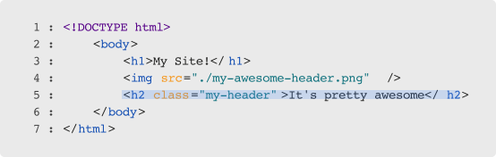

querySelector by Class
Notes:
Or by class, using the '.' just like we would in CSS

Slide 16
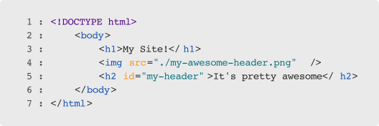

Question
How would we select the H2 tag by ID?

Slide 17
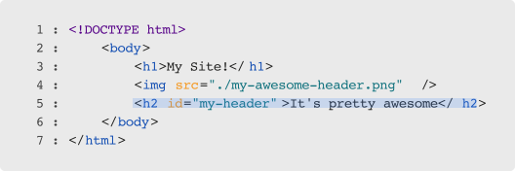

Answer
By using a #

Slide 18




Passing Selectors
Remember to pass the selector as a string:
This will work
This will not

Slide 19
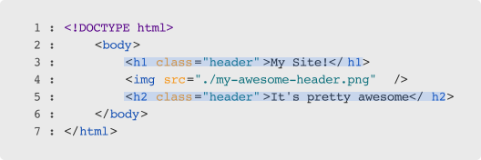

querySelectorAll
Notes:
If you want all of the elements that match a specific selector, you can use querySelectorAll.
It will return an *array like* list of DOM elements

Slide 20

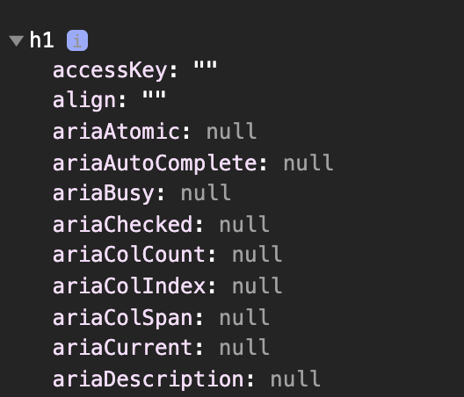
Working with DOM Elements
Consult documentation often
We'll start with one helpful property: .style
Notes:
DOM Elements have a ton of methods & properties, use documentation (w3schools, mozilla) when you're trying to do something specific
One property we can accomplish quite a bit with is .style

Slide 21
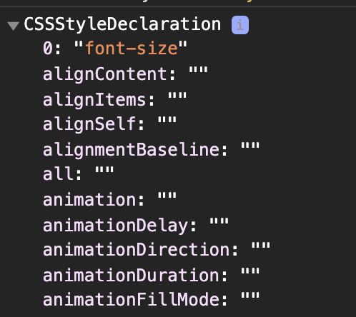
.style
An object which represents CSS rules
Notes:
Changing the properties of a style object will change the CSS for a specific element!

Slide 22

.style property names
Any CSS Property Name (font-family)
In camel-case (fontFamily)

Slide 23

.style property values
Any CSS Property value (Arial)
Expressed as a string ('Arial')

Slide 24

Activity: JS Graffiti
Let's practice modifying an HTML page with JavaScript!

